Slide 1
A Marketing Perspective
Rare Products

Slide 2
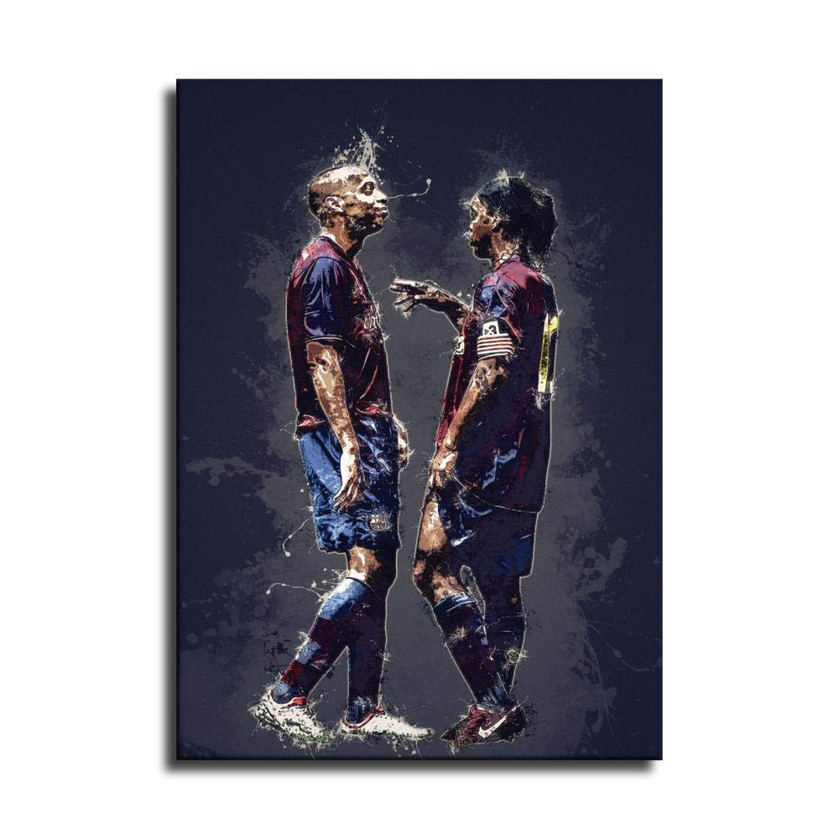
Executive Summary
At Rare Products, we redefine the art of framing, introducing a diverse range of wooden frames that seamlessly fuse tradition with modernity. Our collection caters to the unique tastes of the new generation, offering a distinctive blend of rare and customizable options. From cutting-edge NFT frames for digital art enthusiasts to timeless calligraphy frames and dynamic sports-related frames, we have curated a portfolio that sets a new standard in the framing industry.

Slide 3
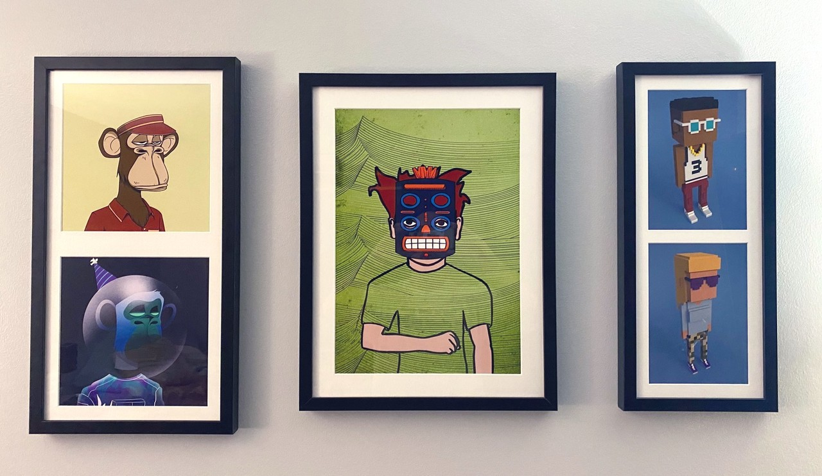
Overview of Product Categories
NFT Frames

Slide 4
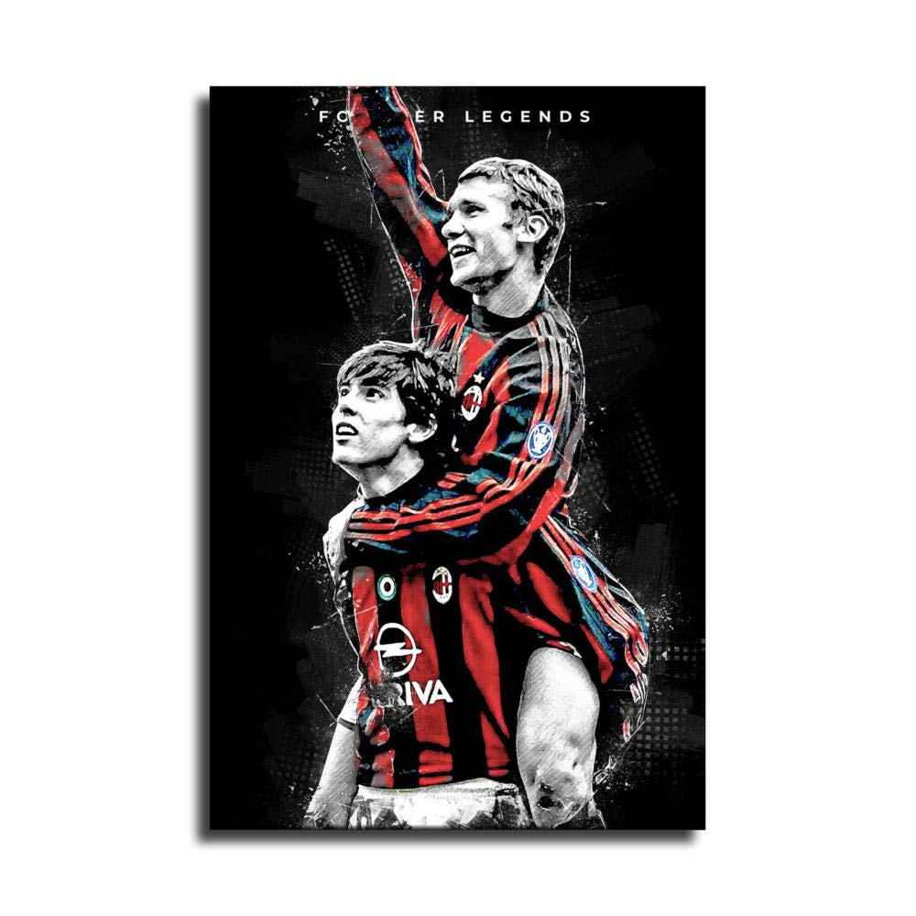
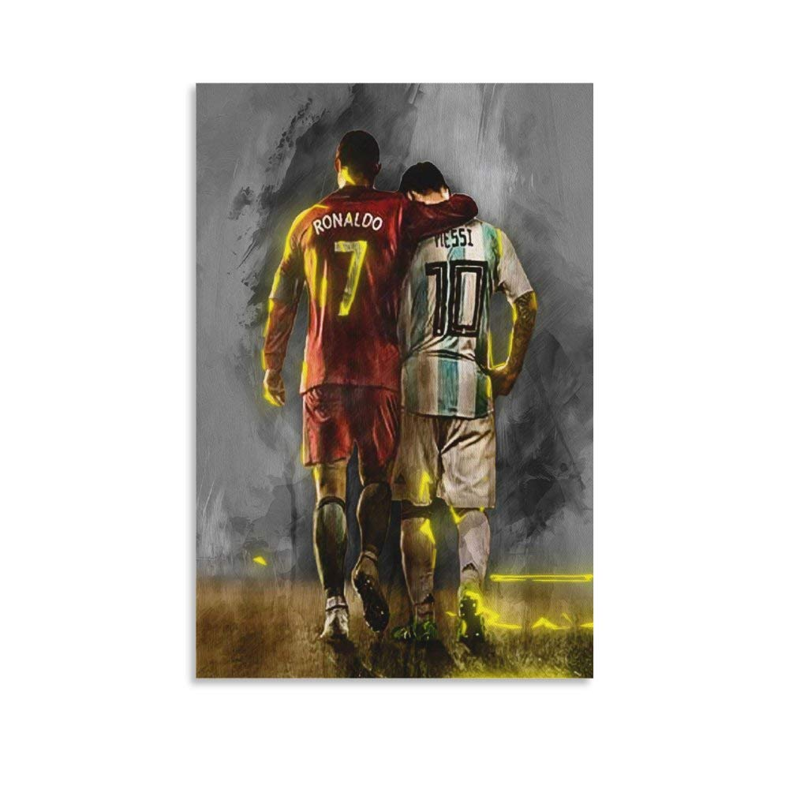
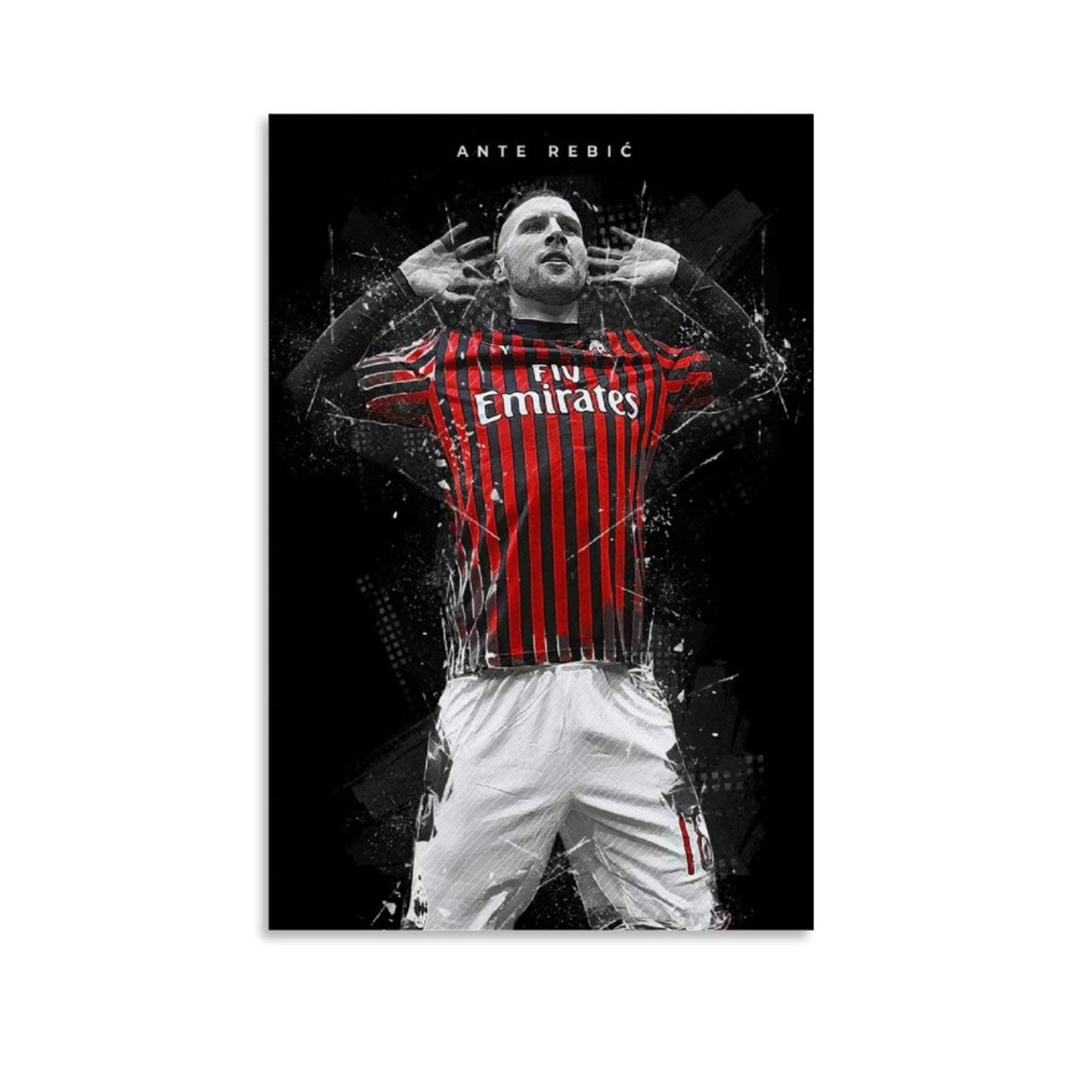
Sports Frames

Slide 5


Calligraphy Frames

Slide 6
Target Audience
Age Range: 18-30 years
Individuals with a passion for digital art.
NFT Frames
Age Range: 20-60 years
Appreciation for traditional and timeless art.
Sports Frames
Age Range: 20-50 years
Sports enthusiasts and fans.
Calligraphy Frames

Slide 7
SWOT Analysis
Quality
Timely delivery
Customer satisfaction.
Limited product range
Limited market presence
Limited international presence
S
W
Strength
Weakness
S
W
O
T
Opportunity
Threats
O
T
Art exhibitions
Trend exploration
E-commerce growth
Competition
Price inflation
Economic factors

Slide 8
Vision & Mission
Mission
Delivering Rare and Customized Artistry
Enhancing Spaces with Nostalgia and Quality
Fostering a Culture of Art Appreciation
Vision
Becoming the Go-To Source for Rare Art Items
Expanding Locally and Internationally
Enriching Lives through Unique Artistic Expressions

Slide 9
Marketing Approach
Current Focus:
Customer Satisfaction
Word-of-Mouth Referrals
Logical SEO Practices
Future Strategies:
Social Media Expansion (e.g., Facebook)
Paid Marketing Channels (e.g., Google Shopping)
Innovation in Showcase:
Exploring Creative Avenues
Highlighting Rare and Customizable Offerings

Slide 10

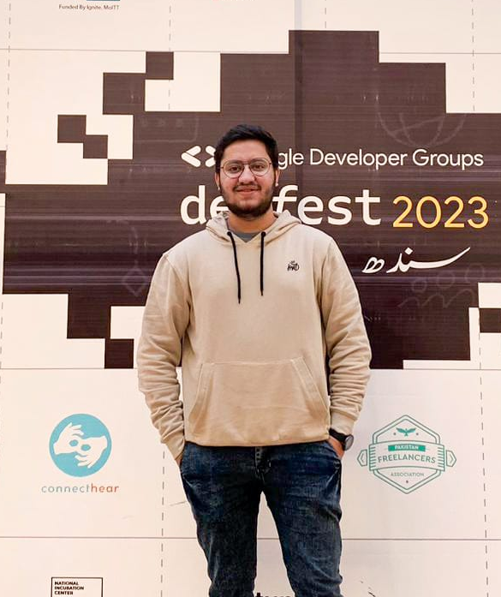

Our Team
M. Huzaifa Khan
S. Hashir Hussaini
Ammad Zafar
Chief Executive Officer
Chief Technical Officer
Advertising Manager

Slide 11
Conclusion
In conclusion, Rare Products is poised to make a significant impact in the art and customization market. With a commitment to delivering quality, unique, and customizable items, we are well-positioned to capture a diverse market segment. Our focus on art lovers, coupled with strategic opportunities like art exhibitions and exploring emerging trends, will drive our growth. While we acknowledge challenges such as competition and economic factors, our dedication to customer satisfaction and continuous improvement will mitigate potential threats. Rare Products is not just a brand; it's a journey into the world of rare and cherished items, enriching lives and spaces with artistic expressions. Join us in this exciting venture as we redefine the art of customization.

Slide 12
Any Questions?

